Slide 1

Machine Learning Techniques for Automated ULF Wave Recognition in Swarm Time Series
G. Balasis(1), C. Papadimitriou(1,2,3), A. Antonopoulou(1),
S. A. Giamini(1,2,3), Z. Boutsi(1,3), O. Giannakis(1), and R. Haagmans(4)
(1) IAASARS – National Observatory of Athens (NOA),
(2) Space Applications and Research Consultancy (SPARC),
(3) National & Kapodistrian University of Athens,
(4) ESTEC, European Space Agency
Machine Learning in Heliophysics
21-25 March 2022, Boulder (CO), USA

Slide 2
Outline
Introductory part
ESA Swarm Mission
ULF Waves
Time-Frequency Analysis (TFA) Tool for Automated ULF Wave Recognition
Swarm ULF Wave Events & Power Maps
Machine Learning Approach (MLA) for Automated ULF Wave Recognition
Machine Learning in Heliophysics
21-25 March 2022, Boulder (CO), USA

Slide 3
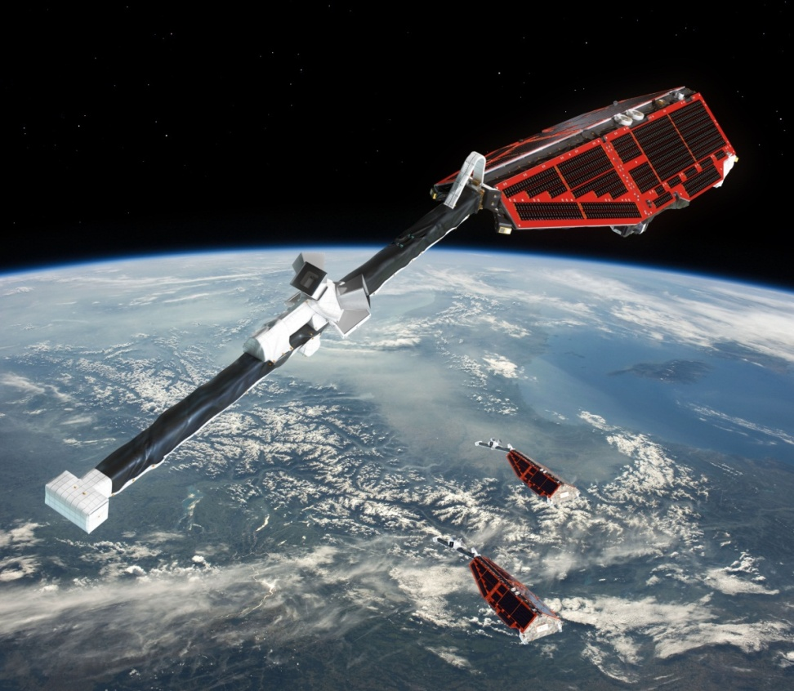
ESA Swarm mission
Each satellite is measuring:
Strength and direction of the magnetic field
Plasma conditions and characteristics
Location
The Constellation:
3 identical satellites:
2 side-by-side in low orbit (<460km)
1 in higher orbit (< 530km)
three orbital planes for optimal coverage in space and time
Launch 22 November 2013: initially 4 years of operations, currently extended through 2021
Copyright / ESA and AOES Medialab
The primary aim of the mission is to provide the best survey ever of the geomagnetic field and the first global representation of its variations on time scales from less than a second to several years.
Machine Learning in Heliophysics
21-25 March 2022, Boulder (CO), USA

Slide 4
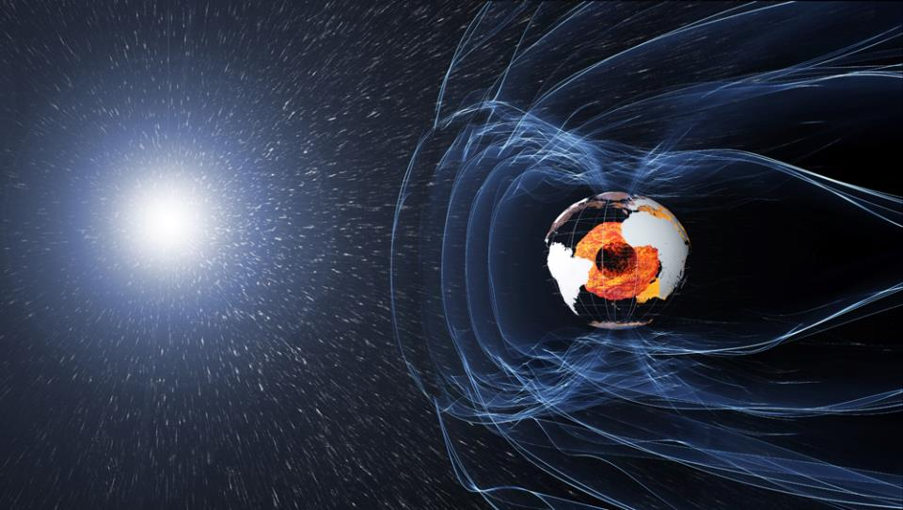
Looking into the force that protects Earth
Understanding the weakening of Earth’s protective shield
magnetosphere
ionosphere
solar wind
Studying the effect of solar charged particles near Earth and the connection to space weather
Sun’s influence on Earth’s system
Machine Learning in Heliophysics
21-25 March 2022, Boulder (CO), USA

Slide 5
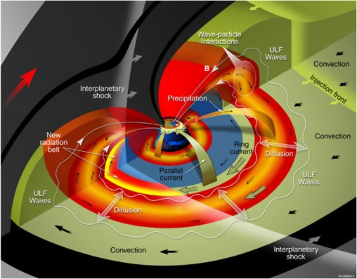
ULF Waves
Pulsation classes
 | Continuous pulsations |  |  |  |  | Irregular pulsations
 | Pc 1 | Pc 2 | Pc 3 | Pc 4 | Pc 5 | Pi 1 | Pi 2
T [s] | 0.2-5 | 5-10 | 10-45 | 45-150 | 150-600 | 1-40 | 40-150
f | 0.2-5 Hz | 0.1-0.2 Hz | 22-100 mHz | 7-22 mHz | 2-7 mHz | 0.025-1 Hz | 2-25 mHz
Ultra-low frequency (ULF) magnetospheric waves originate when magnetic fields and plasma interact in the Earth’s magnetosphere (Alfven MHD waves in plasmas).
A fast compressional mode wave was assumed to originate at the magnetopause and propagate earthward through regions of increasing Alfven speed.
At the point where the wave frequency matches the local field line eigenfrequency, the compressional mode disappears and its energy is transferred into the transverse, shear Alfven mode.
Machine Learning in Heliophysics
21-25 March 2022, Boulder (CO), USA

Slide 6
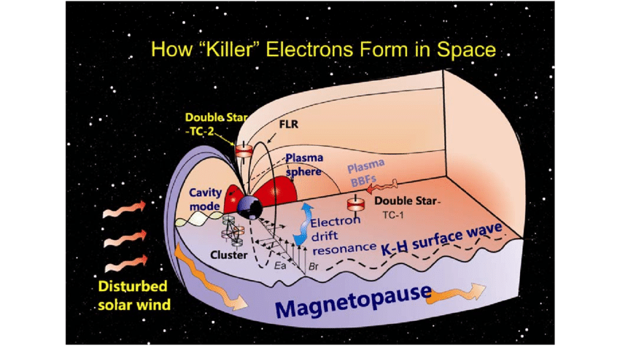
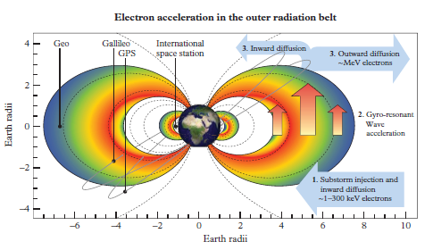
ULF wave importance
ULF waves play a central role in the dynamics of the inner magnetosphere.
They are thought to be an important mechanism for energy transfer from the solar wind to magnetosphere and for accelerating and scattering higher energy particles in the radiation belts through radial diffusion and pitch-angle scattering.
They can also result in adverse space weather effects, such as errors in GPS signals, enhanced Joule heating, and geomagnetically induced currents that affect power networks.
(after Zong, 2011; Horne, 2007)
Machine Learning in Heliophysics
21-25 March 2022, Boulder (CO), USA

Slide 7
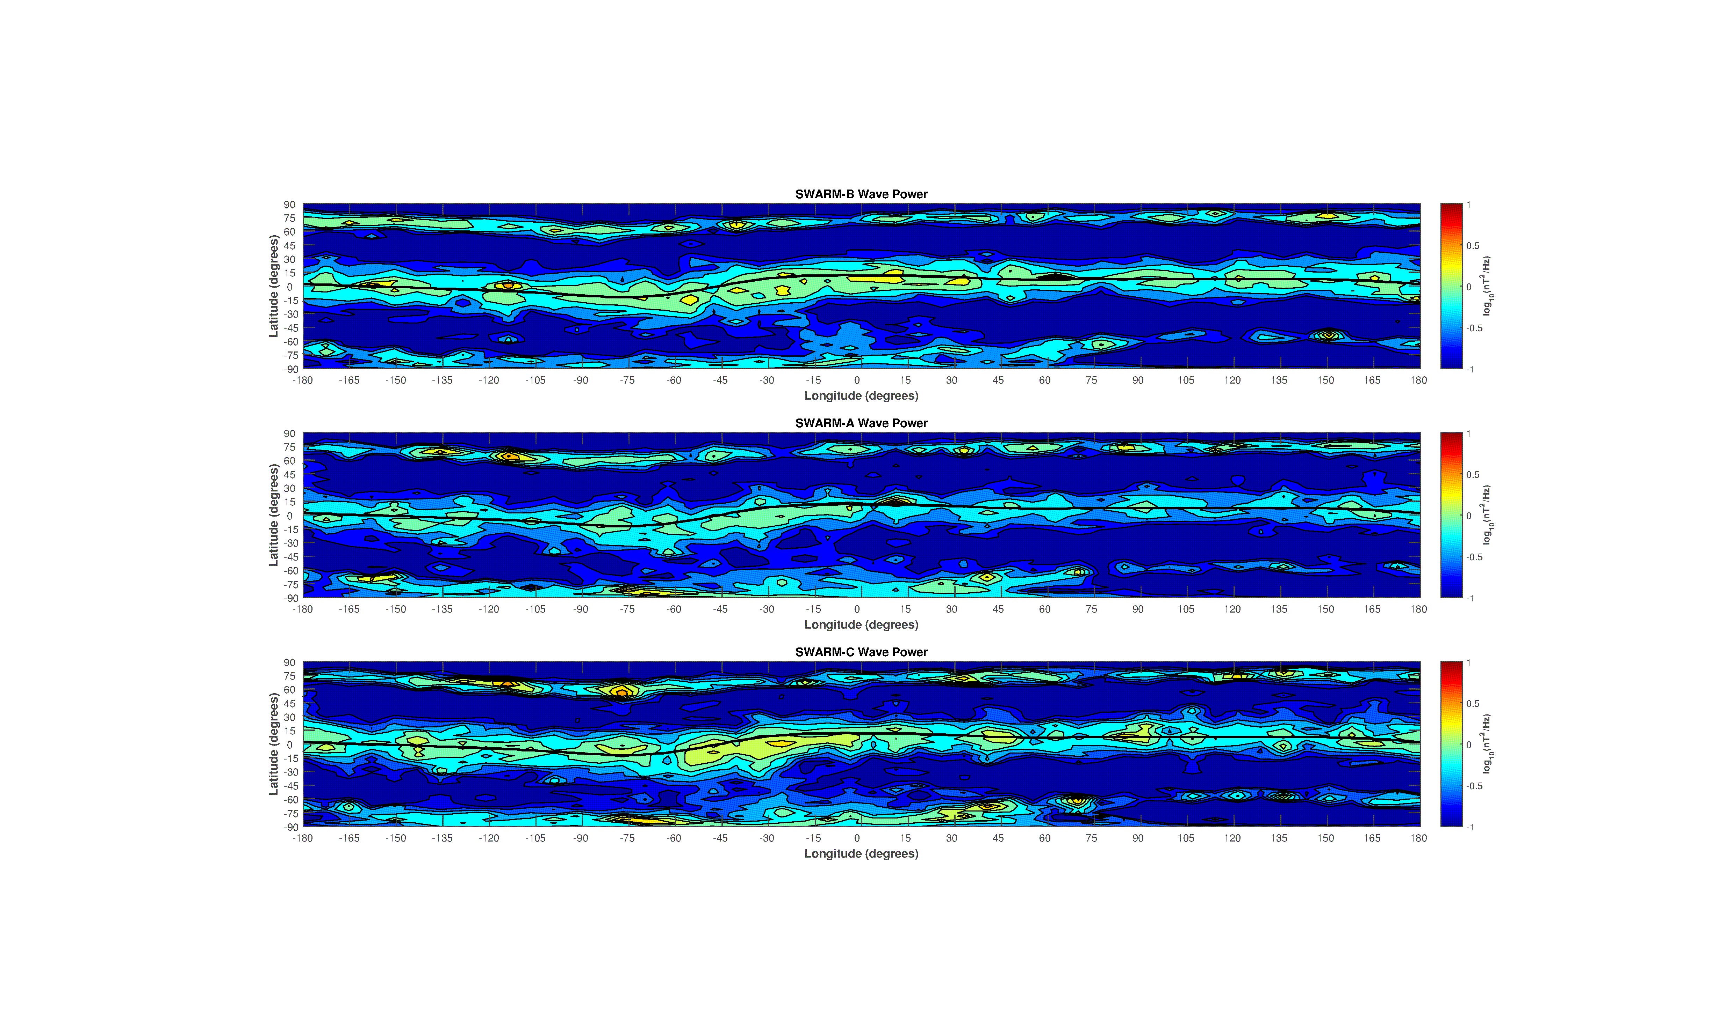
Swarm Pc3 power wavemaps (2 years, 20000 tracks/satellite)
South Atlantic Anomaly
Balasis et al. (GRL, 2015)
Machine Learning in Heliophysics
21-25 March 2022, Boulder (CO), USA

Slide 8
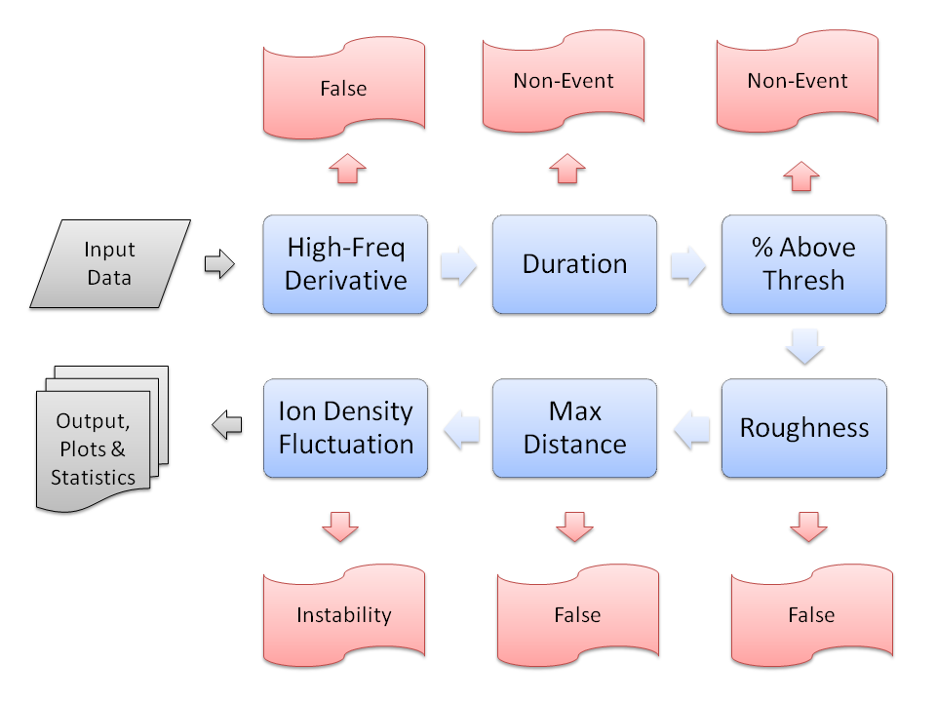
ULF Wave Detection & Classification
Magnetic Field Data
High-Pass Filtered at 20 mHz
Wavelet Spectrum
Separated into Tracks
For each track:
Identify times of consecutive points which show Pc3 activity
Pass each such candidate through a series of tests to identify its nature
Final Classification Categories
Background
Pc3 Events
False Positives
Plasma Instabilities (IBI & FAC related)
Balasis et al. (2013), “Magnetospheric ULF wave studies in the frame of Swarm mission: a time-frequency analysis tool for automated detection of pulsations in magnetic and electric field observations”. Earth Planets Space, 65 (11), 1385–1398.
Machine Learning in Heliophysics
21-25 March 2022, Boulder (CO), USA

Slide 9
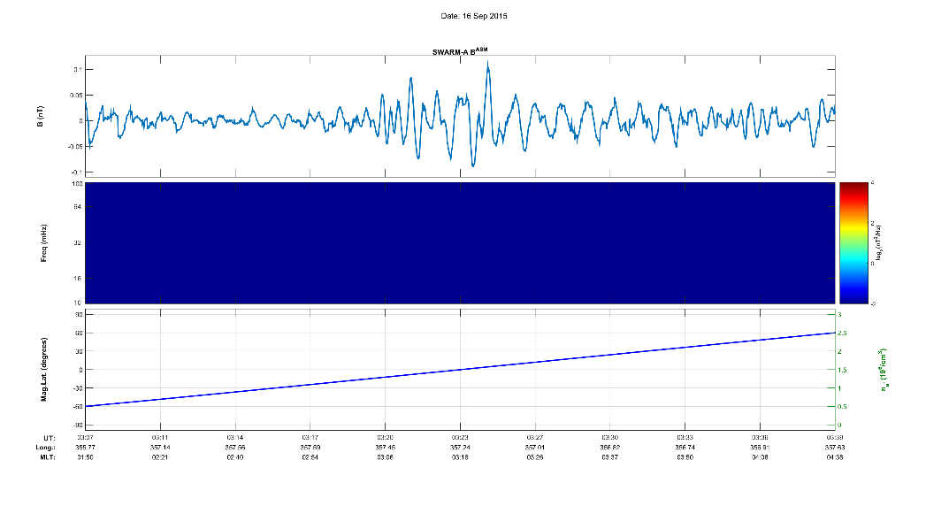
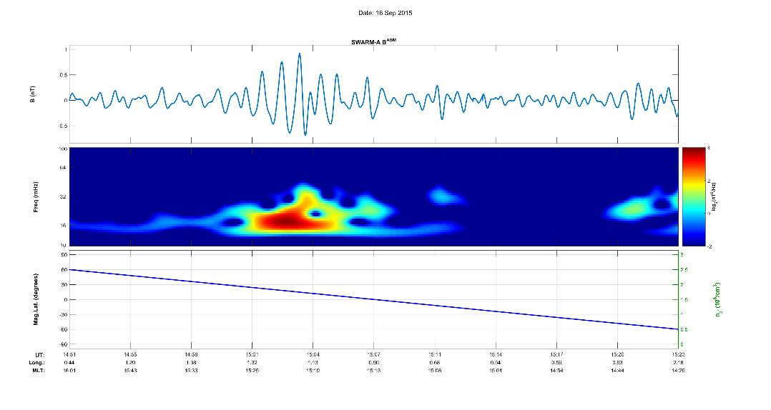
ULF Wave Detection & Classification
Background Signal
Pc3 Event
Machine Learning in Heliophysics
21-25 March 2022, Boulder (CO), USA

Slide 10
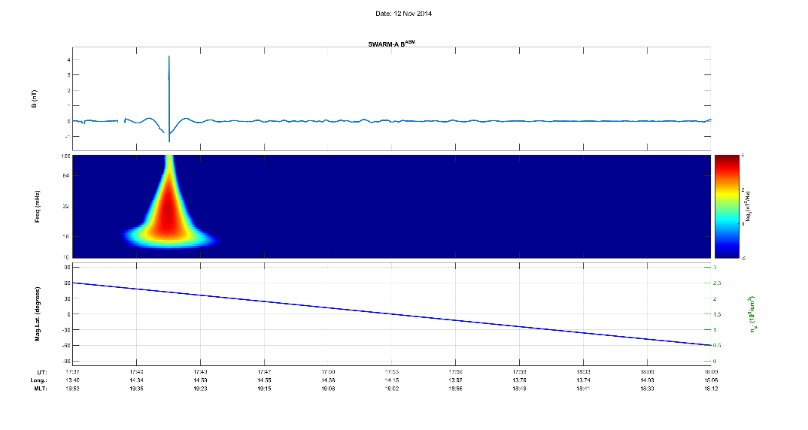
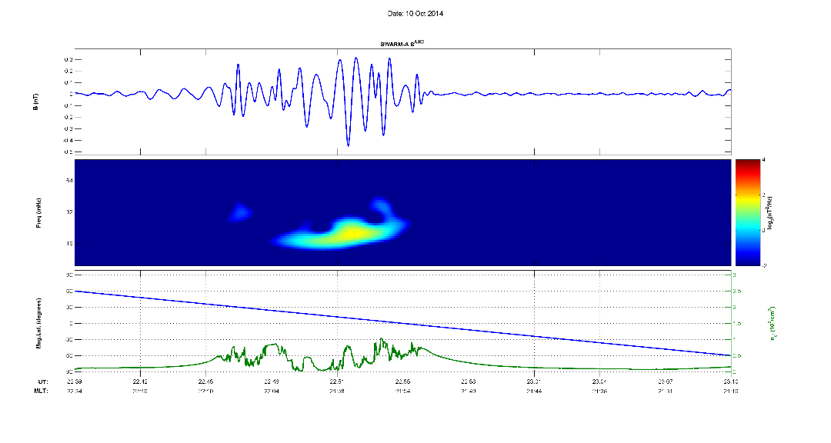
ULF Wave Detection & Classification
False Positive
Plasma Instability
Machine Learning in Heliophysics
21-25 March 2022, Boulder (CO), USA

Slide 11
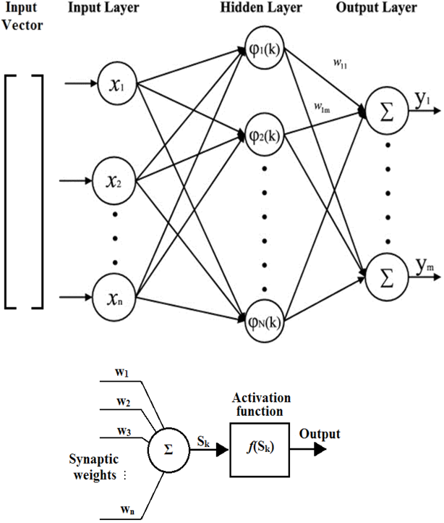
Artificial Neural Networks
Input parameters define the input layer
Weighted sums of them are being passed to the “neurons” of the hidden layer where a certain “activation function” resides
The output of this function becomes a new input for the next hidden layer
… the process continues for all the hidden layers…
At the final step, the outputs are weighted and summed to produce the final value(s)
Classification tasks usually operate by assigning a series of thresholds to this value and performing the categorization accordingly
[-Inf, a₁] -> Class₁
(a₁, a₂] -> Class₂
…
(a_{N}, +Inf] -> Class_{N+1}
Machine Learning in Heliophysics
21-25 March 2022, Boulder (CO), USA

Slide 12
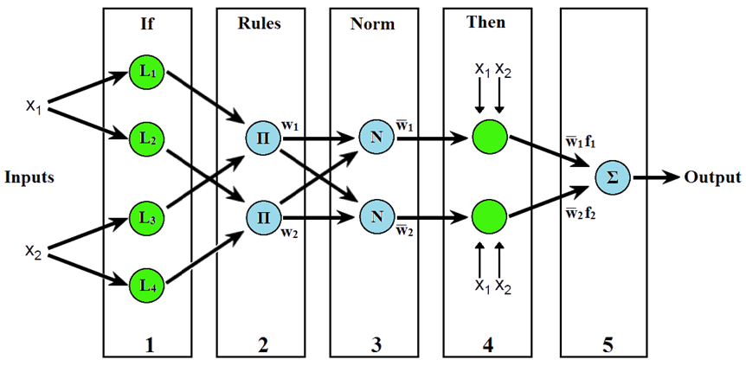
Adaptive Neuro-Fuzzy Inference System (ANFIS)
Similar structure to general ANNs, but trying to implement “If-Then” types of rules
In the simple 1st order case:
Rule 1: If x1 is L1 and x2 is L3 Then f1
Rule 2: If x1 is L2 and x2 is L4 Then f2
with f1 and f2 simple linear functions:
f₁ = p₁x₁ + q₁x₂ + r₁
f₂ = p₂x₁ + q₂x₂ + r₂
Shing, Jyh & Jang, Roger - ANFIS: Adaptive-Network-Based Fuzzy Inference System, IEEE Transactions On Systems, Man and Cybernetics, Vol. 23, No. 3, May/June 1993
Machine Learning in Heliophysics
21-25 March 2022, Boulder (CO), USA

Slide 13
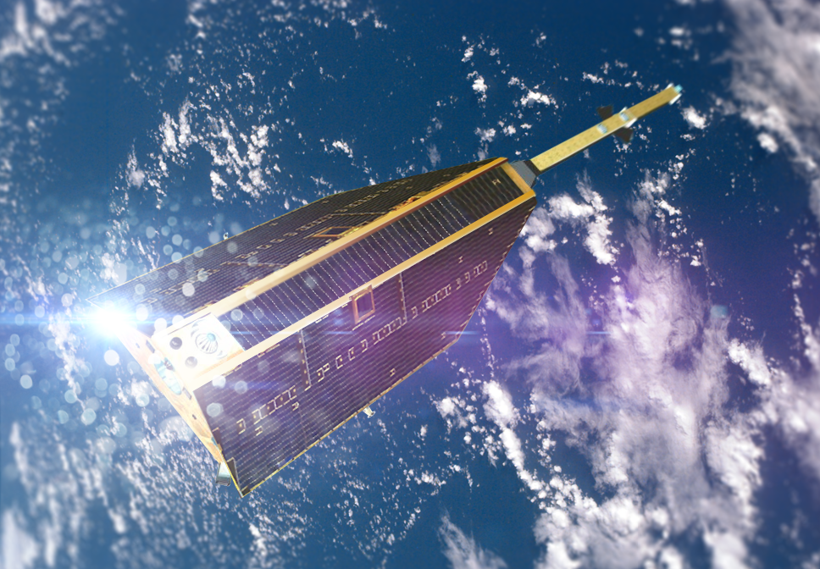
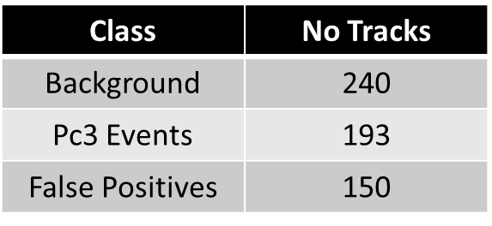
Dataset 1
CHAMP FGM Total Magnetic Field
High passed at 20 mHz
Separated into tracks
Separated into Dayside & Nightside sets
Manually selected cases (most representative of each class)
Half for training – Half for validation (random)
No Spectral Information!
No Plasma Instability Class (no ion density information was provided to the system)
Machine Learning in Heliophysics
21-25 March 2022, Boulder (CO), USA

Slide 14
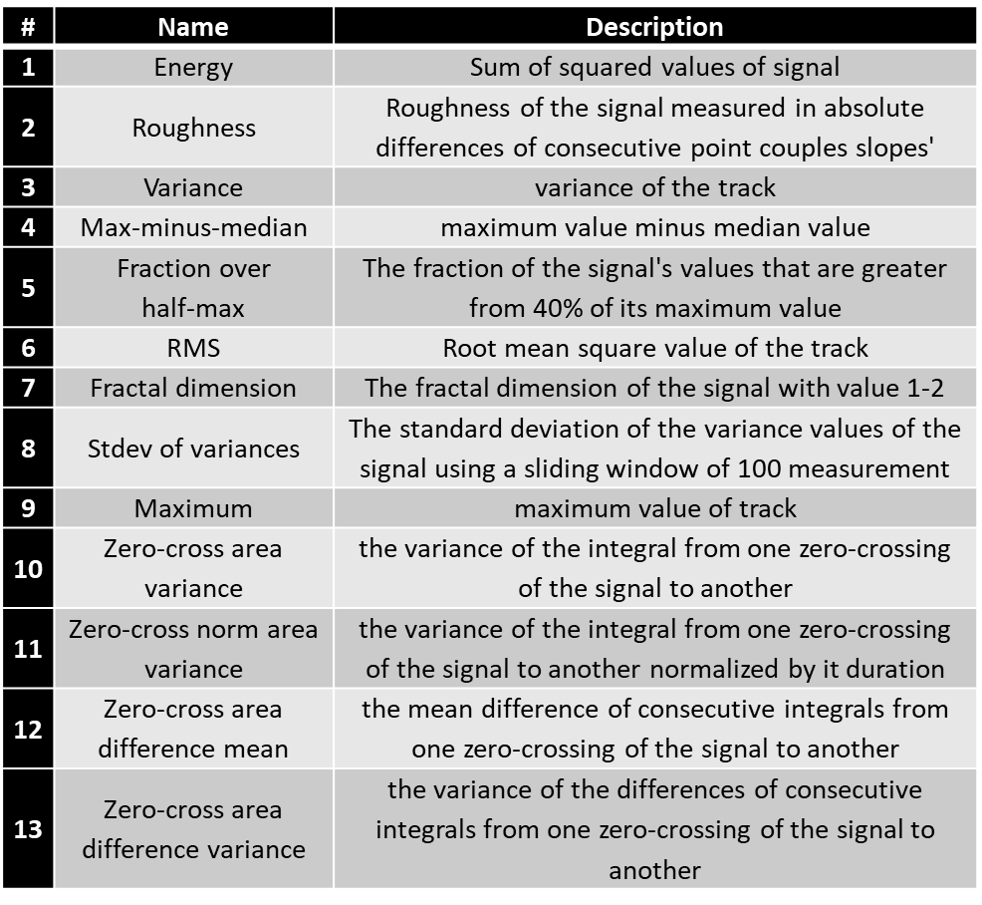
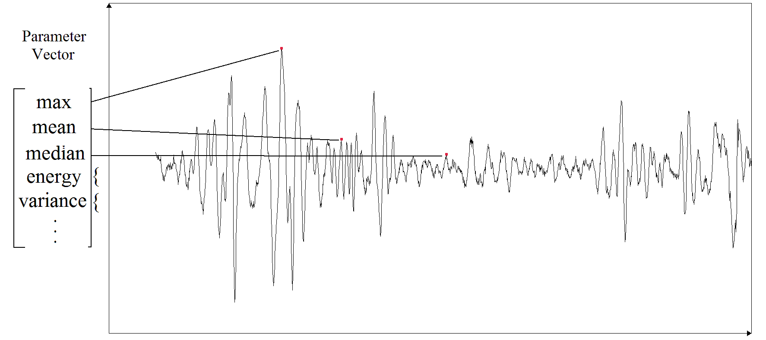
Input Parameters
Machine Learning in Heliophysics
21-25 March 2022, Boulder (CO), USA

Slide 15
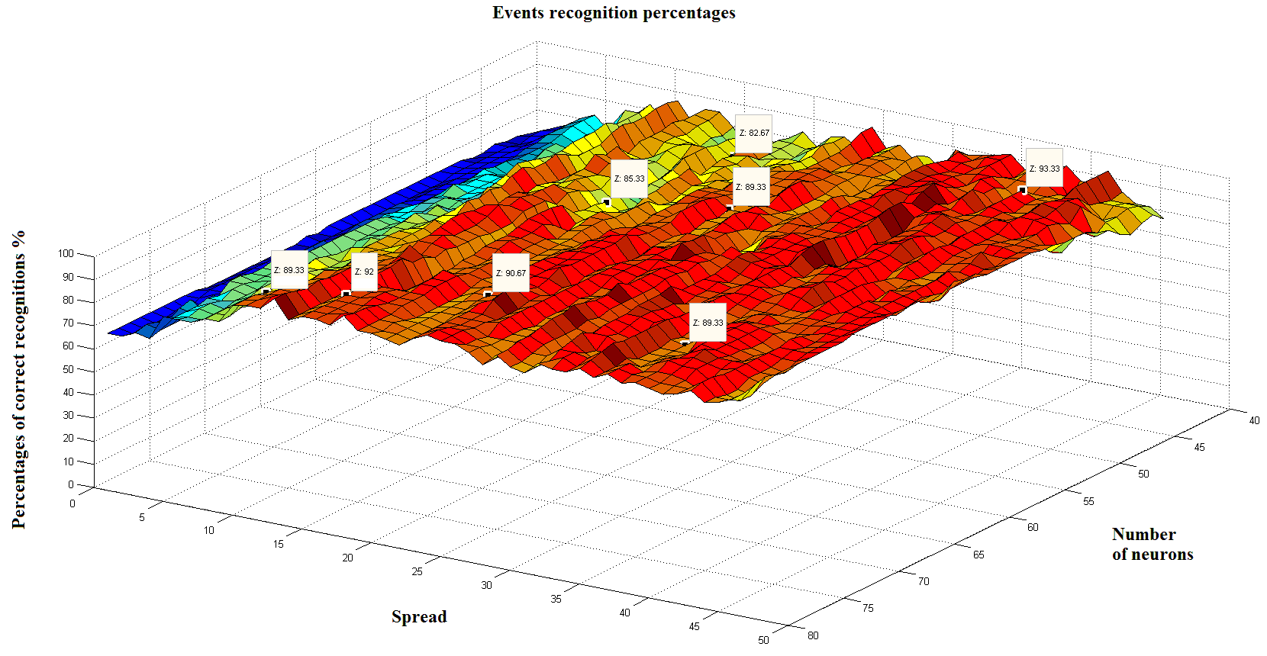
First Results with RBF ANNs
Dayside Results
Background ~ 90%
Pc3 Events ~ 90%
False Positives ~ 100%
Nightside Results
Background ~ 85%
Pc3 Events ~ 85%
False Positives ~ 100%
red & orange areas > 80 %
Machine Learning in Heliophysics
21-25 March 2022, Boulder (CO), USA

Slide 16
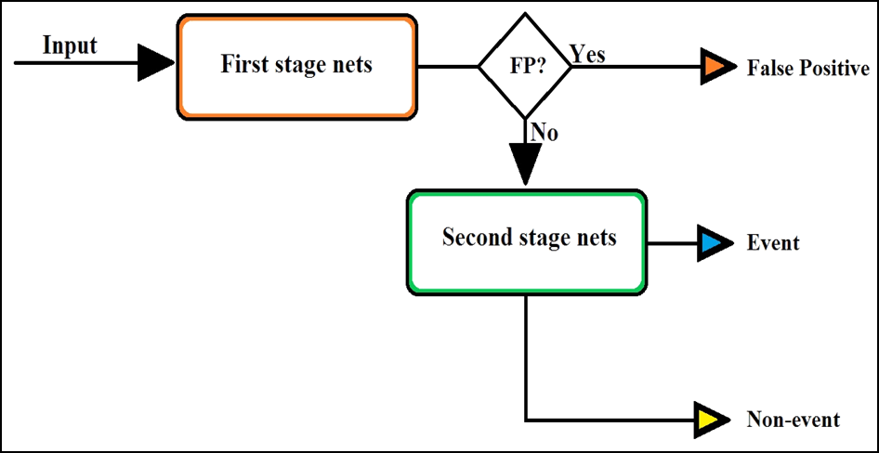
Two-Stage Network Approach
2-Stage Approach
ANFIS Networks
Binary Classification Scheme
Specialized ANN for each task
Different sets of input parameters at each stage
Dataset 2: Automatically Classified CHAMP Tracks (2003-2007)
23,000 Background Tracks
3,700 Events
372 False Positives
Machine Learning in Heliophysics
21-25 March 2022, Boulder (CO), USA

Slide 17
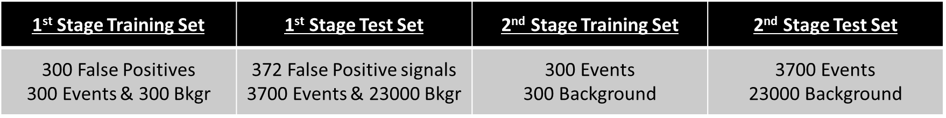
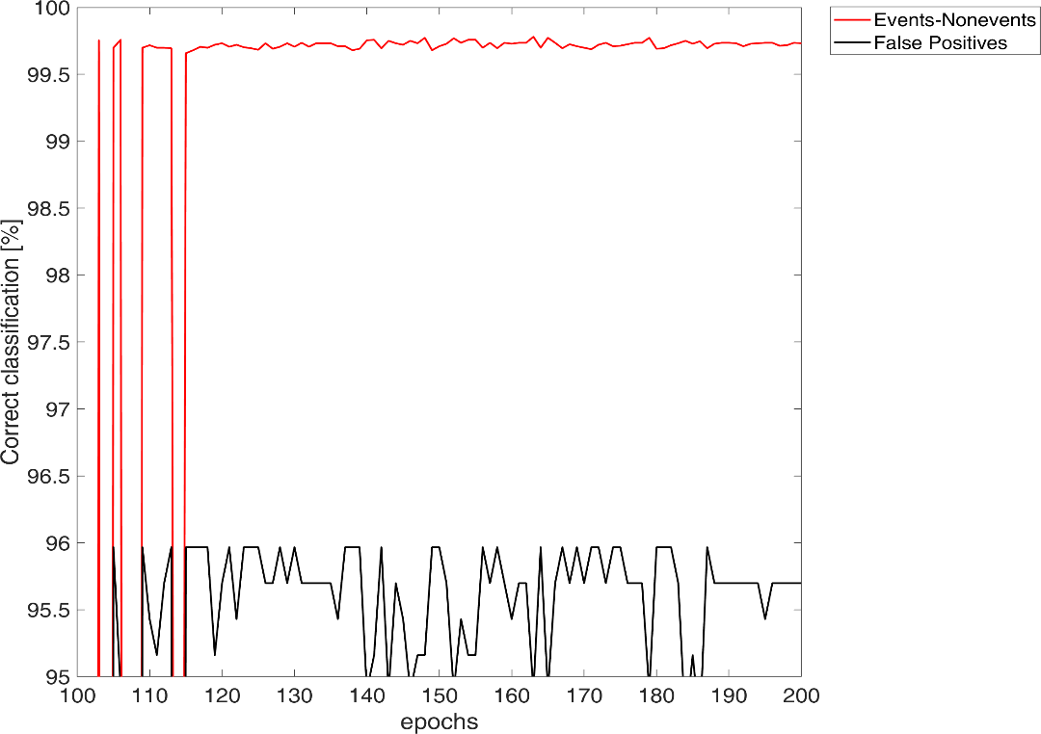
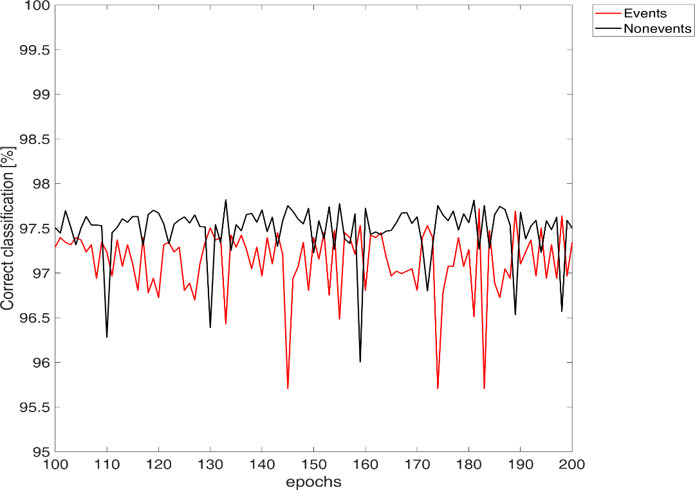
Machine Learning in Heliophysics
21-25 March 2022, Boulder (CO), USA

Slide 18
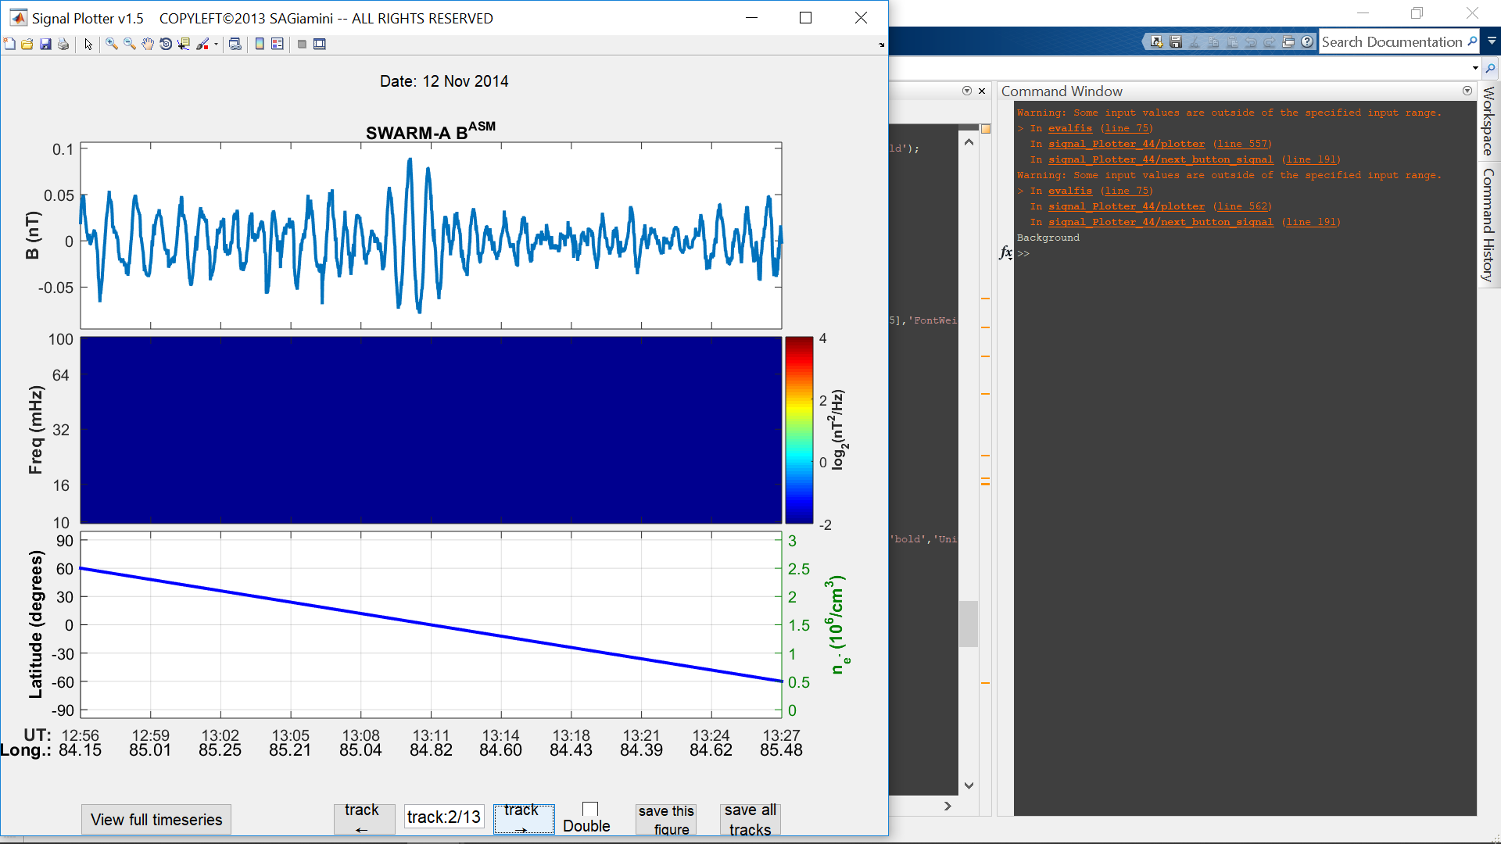
Swarm Test Case Demo
Machine Learning in Heliophysics
21-25 March 2022, Boulder (CO), USA

Slide 19
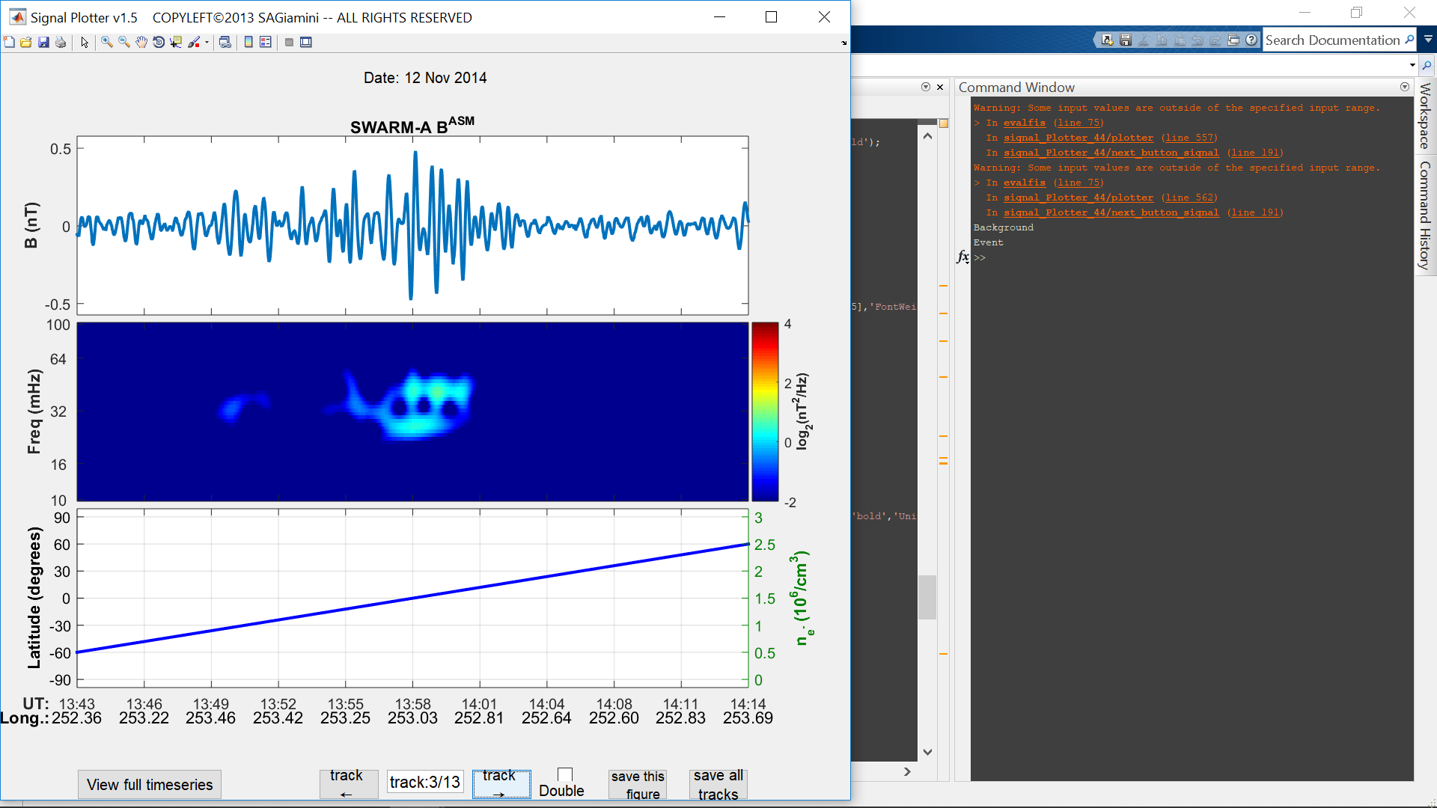
Swarm Test Case Demo
Machine Learning in Heliophysics
21-25 March 2022, Boulder (CO), USA

Slide 20
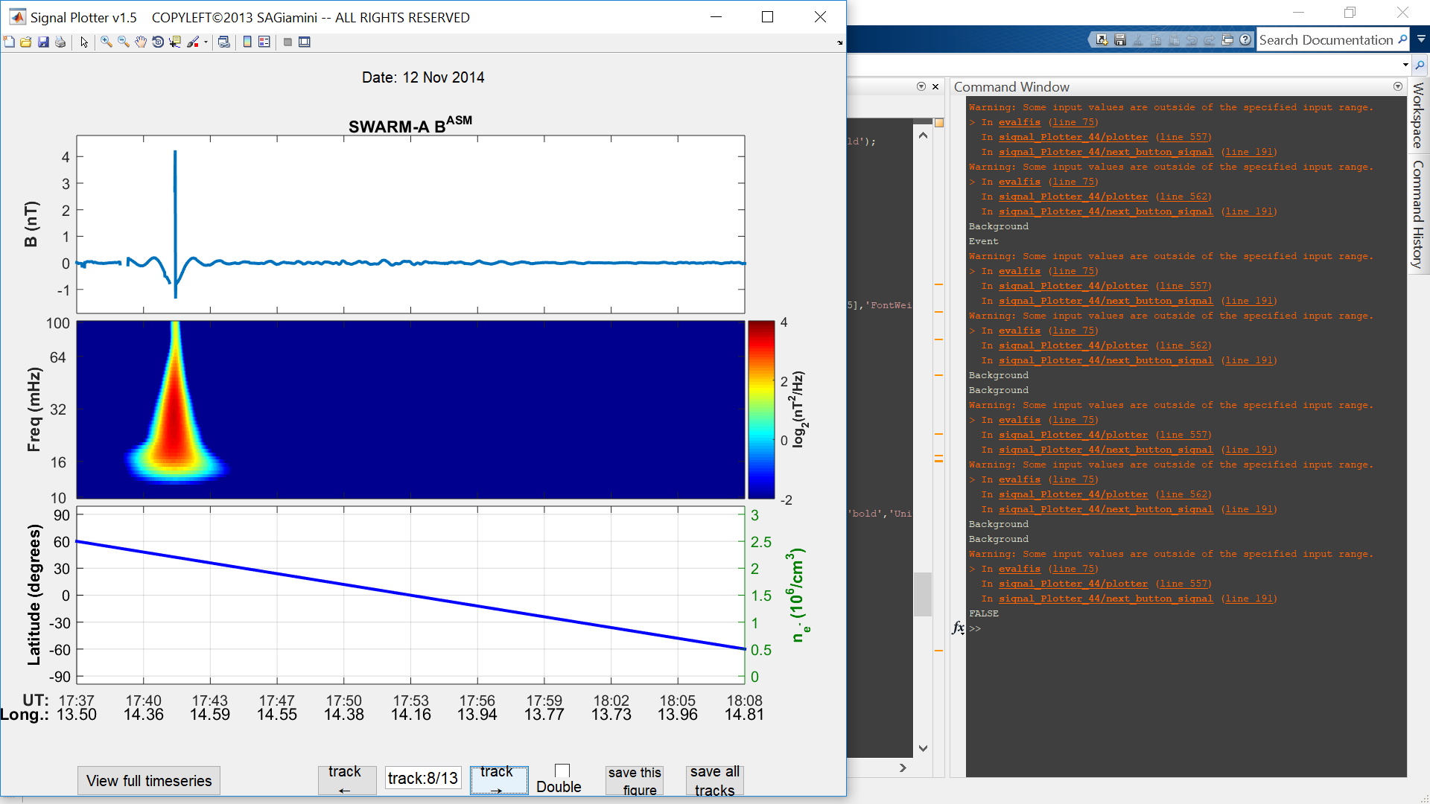
Swarm Test Case Demo
Machine Learning in Heliophysics
21-25 March 2022, Boulder (CO), USA

Slide 21
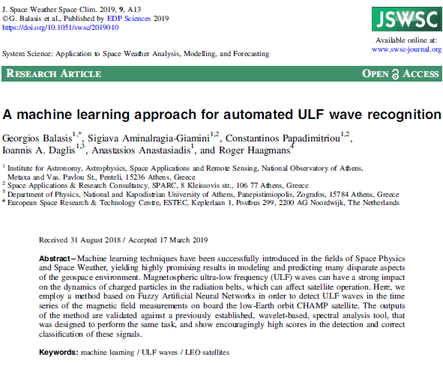
Key Reference
Machine Learning in Heliophysics
21-25 March 2022, Boulder (CO), USA

Slide 22


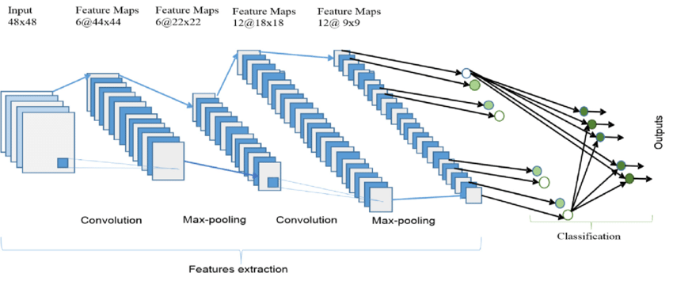
Convolutional Neural Networks (ConvNets)
(Alom et al., Electronics 2019)
The overall architecture of the Convolutional Neural Network (ConvNet) includes an input layer, multiple alternating convolution and max-pooling layers, one fully-connected layer and one classification layer.
[Antonopoulou et al. (in preparation)]
Machine Learning in Heliophysics
21-25 March 2022, Boulder (CO), USA

Slide 23
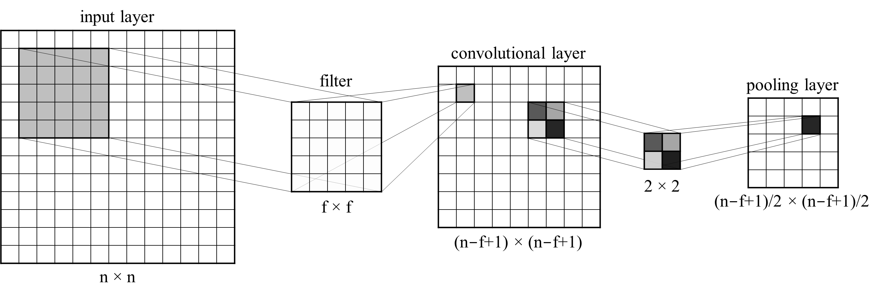
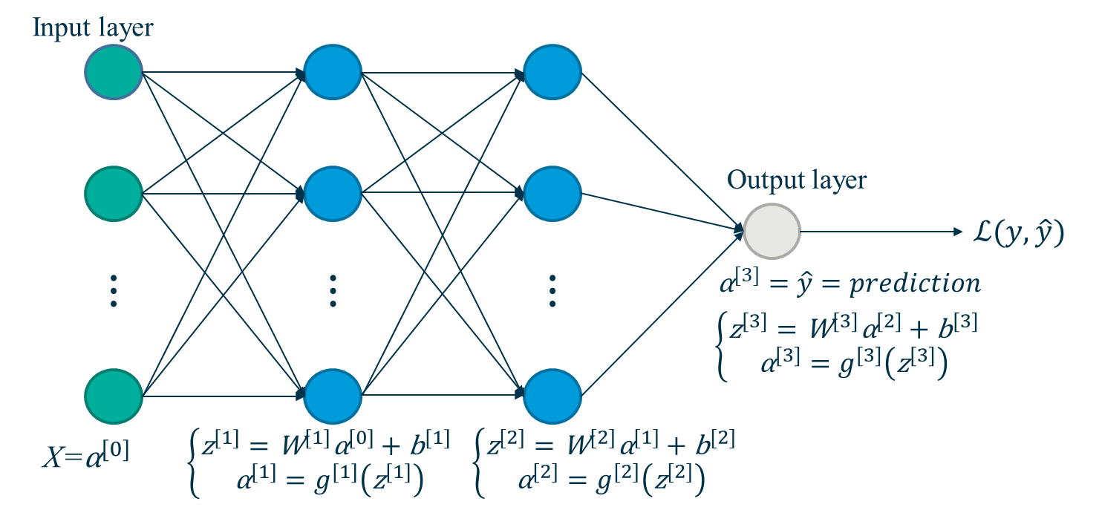
ConvNets
Based on regular neural nets. They are trainable architectures composed of multiple stages.
Each stage is composed of two major layers: a convolutional and a pooling layer.
Convolutional Layer (CONV): a number of trainable filters perform discrete convolution operations on local patches of the input wrt its dimensions. The result of this local weighted sum is then passed through a non-linear function such as a ReLU, relu(x) = max(x, 0). The hyper-parameters of this layer include filter size f and stride s.
Pooling Layer (POOL): its role is to merge semantically similar features into one (LeCun et al., nature, 2015). It takes small rectangular blocks from the CONV layer and subsamples them (examples: max-pooling, avg-pooling).
Fully Connected Layer (FC): the output of the topmost [CONV+POOL] layer is converted into a 1D feature vector (flattening), which passes always through a fully connected layer, with one output unit per class label (Ciresan et al., IJCAI-11, AAAI Press 2011).
Backpropagating gradients through a ConvNet is same as through a regular neural network, allowing all the weights in all the filters to be trained.
FC
→
CONV +
maxPOOL
←
Machine Learning in Heliophysics
21-25 March 2022, Boulder (CO), USA

Slide 24
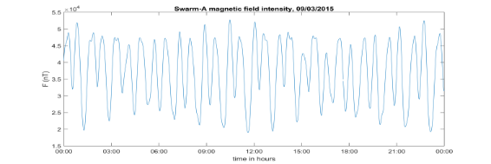
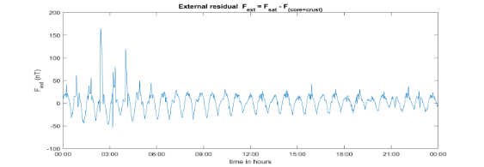
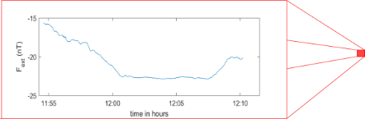
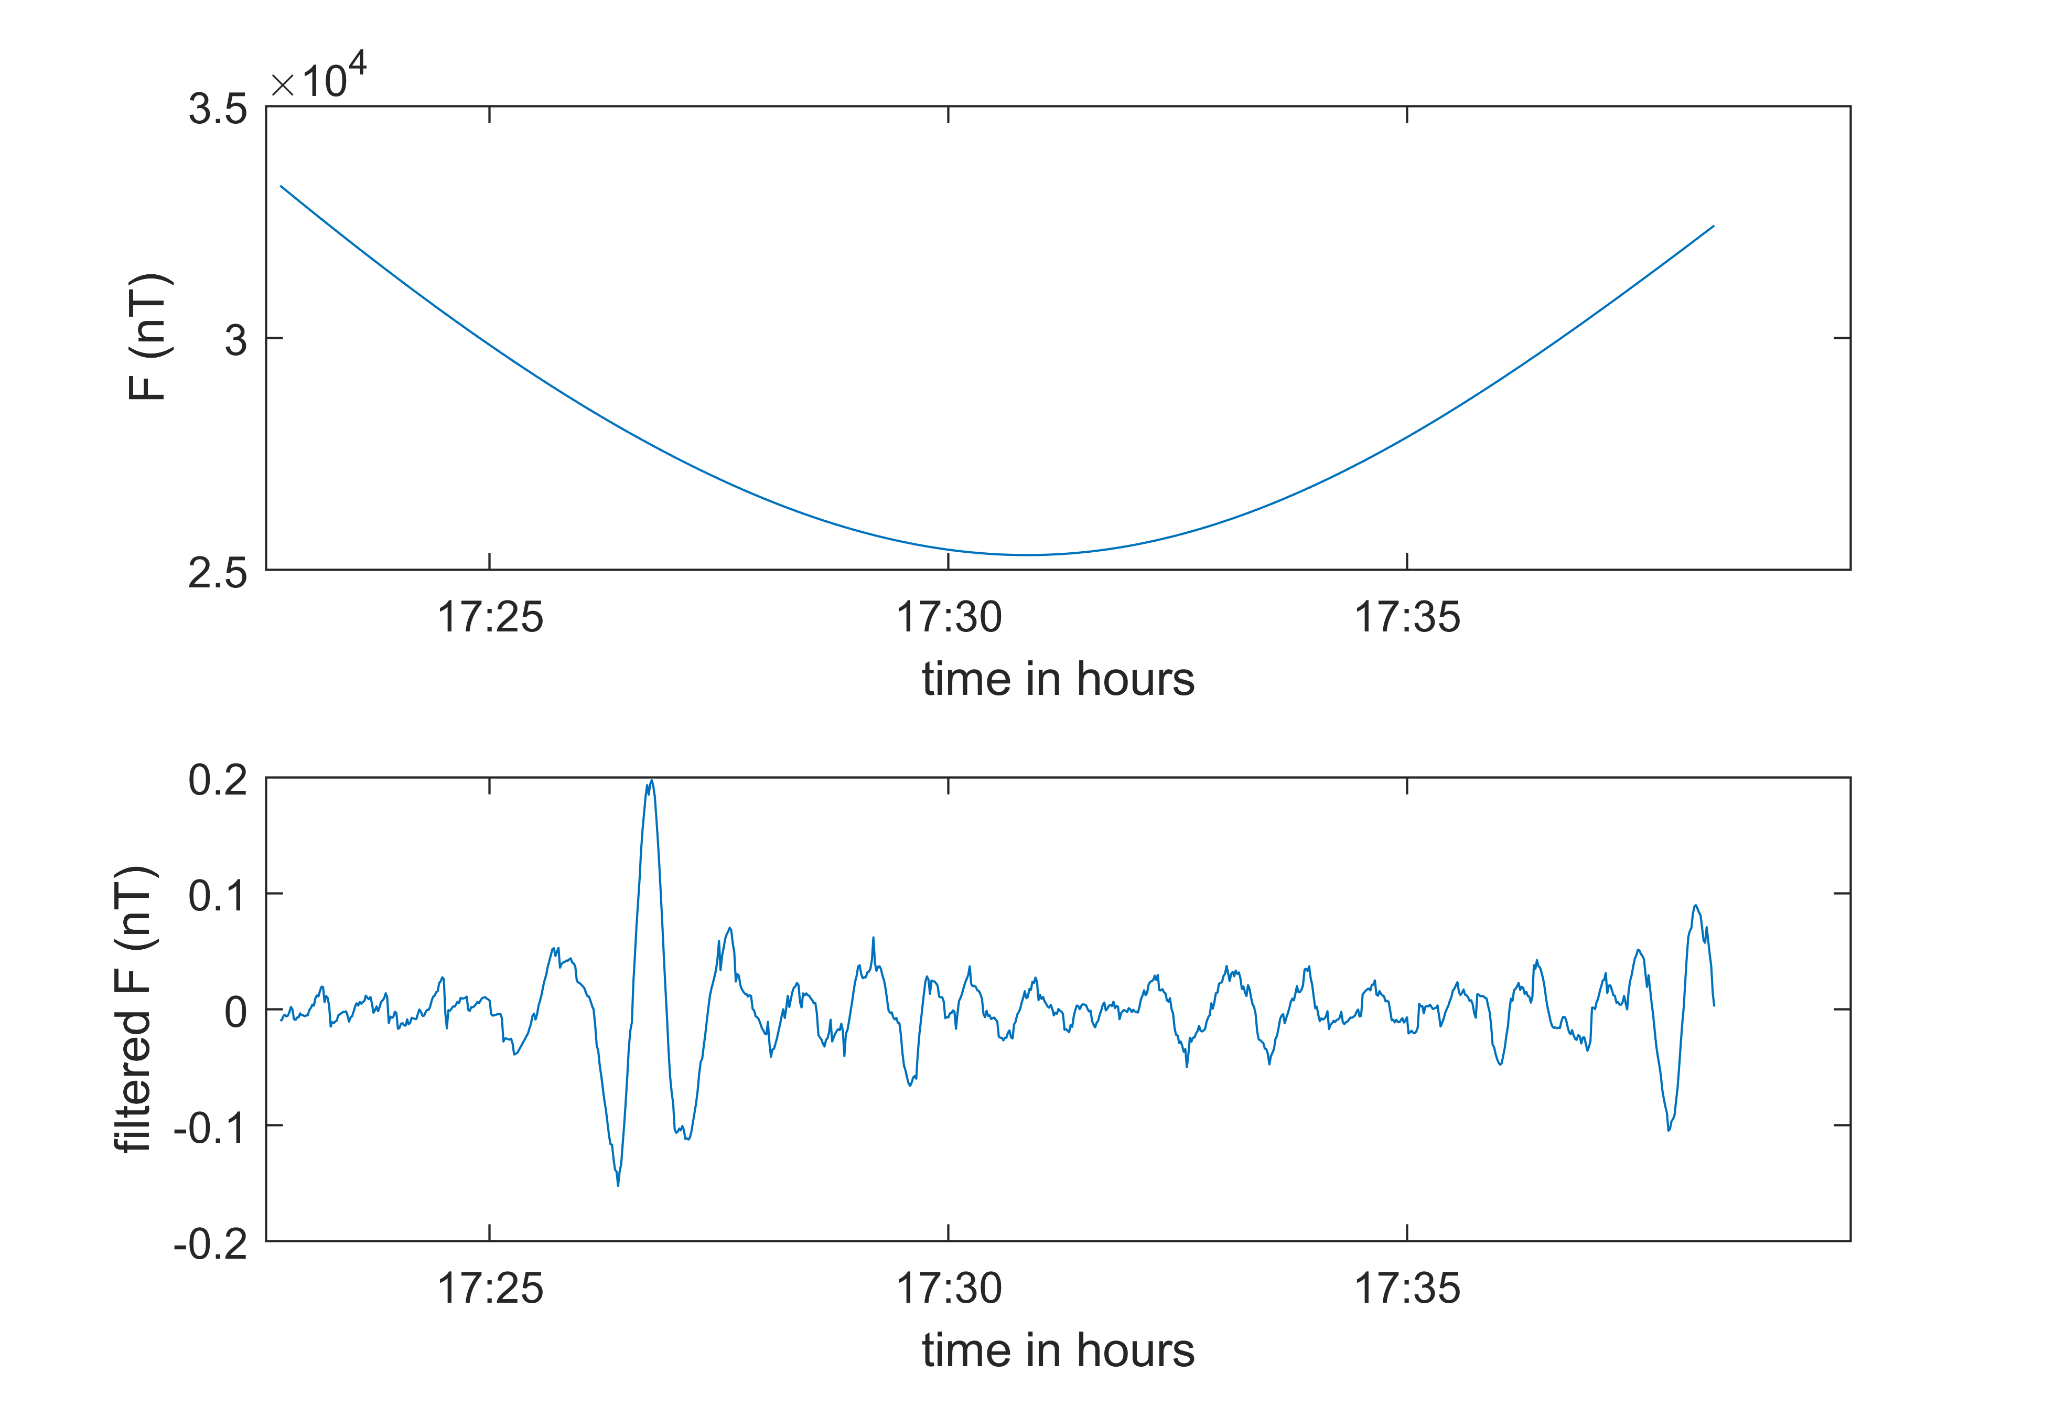
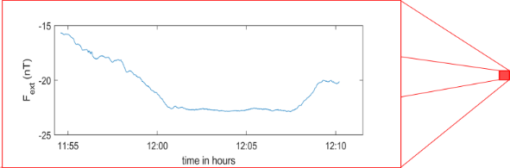
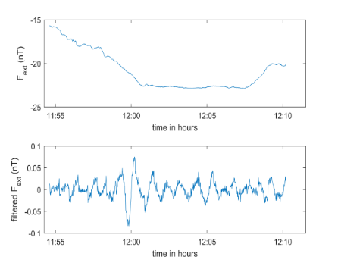
Proposed Methodology
Swarm time series
Subtract the CHAOS-6 model (internal part, i.e., core+lithosphere)
Smaller windows in time:
cut each time series per satellite track
keep only mid-latitudes (±45°)
High pass (HP) Butterworth filter
cut-off = 22 mHz
Wavelet transform
ConvNet
input
output
Probability for each of the 4 classes
Machine Learning in Heliophysics
21-25 March 2022, Boulder (CO), USA

Slide 25
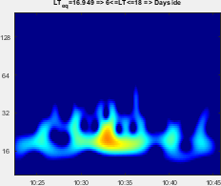
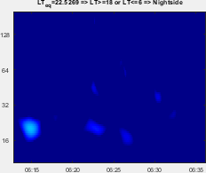
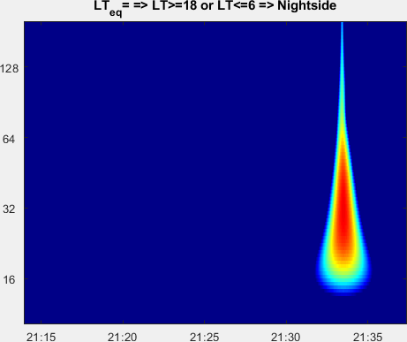
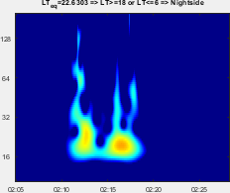
The 4 classes
The classification problem: existence or non-existence of ULF wave events in the Pc3 frequency range
We solve a 4-class classification problem, i.e.,
1st class (“Events”): existence of Pc3 (22 - 100 mHz) ULF wave events
2nd class (“Background”): background noise without significant wave activity (non-ULF signals)
3rd class (“False Positives”): artificial signals due to spikes, discontinuities, etc. (non-ULF signals)
4th class (“Plasma Instabilities”): attributed primarily to Equatorial Spread-F events (ESF, “plasma bubbles”, for details see Stolle et al, JGR 2006), which are post-sunset, equatorial-confined ionospheric anomalies (non-ULF signals)
“Event”
“Background”
“False Positive”
“Plasma Instabilities”
Machine Learning in Heliophysics
21-25 March 2022, Boulder (CO), USA

Slide 26
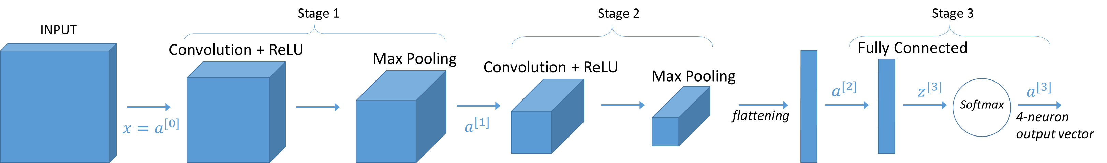
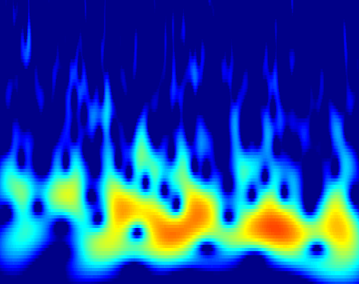
Training of the Network
Data used: total magnitude, extracted from Swarm-C Vector Field Magnetometer (VFM) measurements, NEC frame, 1s sampling rate (low resolution (MAGX_LR_1B Product)), taken from February, March & April of the year 2015.
Number of total samples: 2620 samples, manually annotated in 4 classes
Input: pairs of wavelet images & their annotation (class label)
Training / Test set split: 80% / 20% of total samples
Parameter initializer: Xavier Initialization
Activation functions: ReLU, Softmax
Cost function: Cross-entropy (Log Loss)
Optimizer: Adam Optimization (training for 100 epochs)
Extra: Batch Normalization, Dropout Regularization
Layers | Details
Conv1 | 8 filters, f = 4, s = 1
Pool1 | f = 8, s = 4
Conv2 | 16 filters, f = 2, s = 1
Pool2 | f = 4, s = 4
FC | Prediction, 4-neuron output
Machine Learning in Heliophysics
21-25 March 2022, Boulder (CO), USA

Slide 27

Results
ConvNet performance: confusion matrix, accuracy on each class, overall accuracy and Heidke Skill Score
Overall accuracy on the training set (2096 samples) = 98.3%
Overall accuracy on the test set (524 samples) = 97.2%
Heidke Skill Score (HSS): measures the fraction of correct predictions after eliminating those which would be correct due purely to random chance,
Confusion matrix and accuracies for each class of the test set. The confusion matrix is almost diagonal:
 |  | True label
 | classes | BN | Pc3 | PB | FP
Predicted label | BN | 167 | 2 | 3 | 0
 | Pc3 | 1 | 194 | 7 | 0
 | PB | 0 | 1 | 76 | 0
 | FP | 0 | 0 | 0 | 73
Accuracy (%) | BN
BN | 99.4
Pc3 | 98.5
PB | 88.4
FP | 100
$HSS= \frac{\frac{1}{N}\sum_{i=1}^{K}{n\left(F_{i},O_{i}\right) }−\frac{1}{N^{2}}\sum_{i=1}^{K}{N\left(F_{i}\right)N\left(O_{i}\right)}}{1−\frac{1}{N^{2}}\sum_{i=1}^{K}{N\left(F_{i}\right)N\left(O_{i}\right)}}$ = 96.2%
Machine Learning in Heliophysics
21-25 March 2022, Boulder (CO), USA

Slide 28
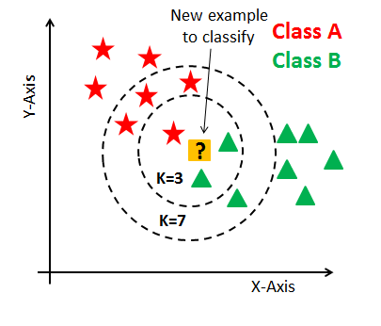
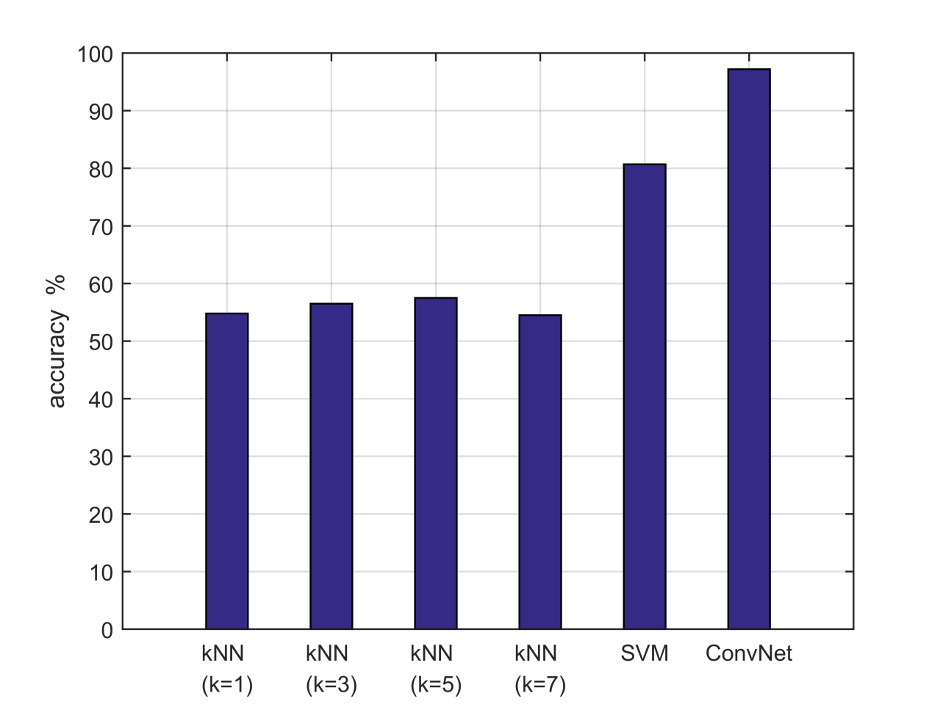
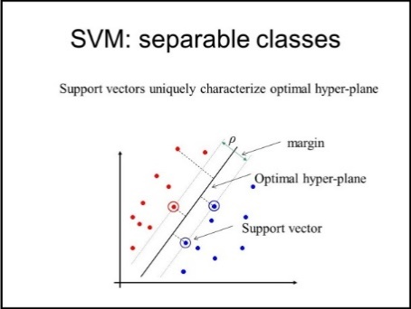
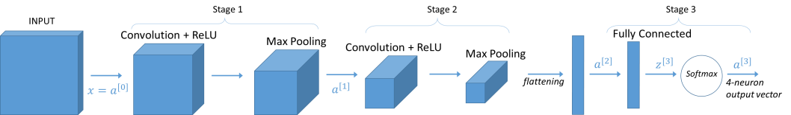
Results
Comparison of the overall accuracy of the test set with the k-Nearest Neighbors (kNN) & Support Vector Machines (SVM) classifiers. ConvNet achieves the highest accuracy.
k-Nearest Neighbors (kNN)
overall accuracy = 57.5%
(for k = 5)
Support Vector Machines (SVM)
overall accuracy = 80.7%
ConvNet
overall accuracy = 97.2%
Machine Learning in Heliophysics
21-25 March 2022, Boulder (CO), USA

Slide 29
Conclusions
ConvNet accuracy on the training set (2096 samples) = 98.3%
ConvNet accuracy on the test set (524 samples) = 97.2%
Heidke Skill Score (HSS) = 96.2%
Comparing with the well-known kNN classifier & the very competitive SVM classifier: kNN (for k=5) = 57.5%, SVM = 80.7%,
→ the ConvNet gives the best results, achieving the highest accuracy.
Machine Learning in Heliophysics
21-25 March 2022, Boulder (CO), USA

Slide 30
Future Work
Re-training with more data, crucial for our methodology to be better-established.
(aim to exploit all the Swarm mission magnetic field data)
Work on the improvement of the accuracy on the “Plasma Instability” class, by introducing into the model information about e.g. Swarm electron density data, nightside or dayside of the satellite track.
The new methodology could be easily applied to investigate:
other frequency ranges of ULF waves than Pc3 events (Pc1/EMIC, Pc2, Pc4 and Pc5)
observations from other satellite missions
ground-based observations
Machine Learning in Heliophysics
21-25 March 2022, Boulder (CO), USA

